Slide 1

6th Grade Math
Unit 4, Lesson 10 Comparing and Performing Operations with Absolute Value Volume 1, pg. 183

Slide 2


Benchmark
MA.6.NSO.1.4
Solve mathematical and real-world problems involving absolute value, including the comparison of absolute value.
volume 1, pg. 183

Slide 3
Integrated Mathematical Thinking and Reasoning Standards
MA.K12.MTR.4.1 Engage in discussions that reflect on the mathematical thinking of self and others.
MA.K12.MTR.6.1 Assess the reasonableness of solutions.
volume 1, pg. 183

Slide 4

Learning Targets
I can compare the absolute value of two numbers.
I can perform operations that involve the absolute values of two numbers.
volume 1, pg. 183

Slide 5

Warm-Up
volume 1, pg. 184

Slide 6
4.10.1 Warm-Up: Rational Numbers in the Real World
For each of the following problems, ask a classmate for his/her explanation. Once you have received their explanation, write a summary in the space provided in the box. Your classmate should read your summary and initial that it is correct. Repeat this with a different classmate for each of the remaining problems.
volume 1, pg. 184

Slide 7
Describe the relationship between two numbers that have the same absolute value. Initials: ______ | In an American football game, the offensive team makes gains or losses on each play. Gains are represented by positive values and losses by negative values. What does 0 represent in this context? Initials: ______
volume 1, pg. 184

Slide 8
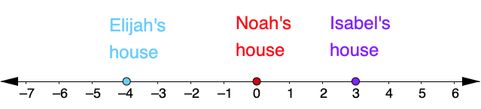
Elijah, Noah, and Isabella live on the same street. The locations of their houses are modeled on the number line. Describe where they live relative to each other in two sentences. Include the words distance and absolute value. Initials: ______
volume 1, pg. 184

Slide 9

Guided Instruction
volume 1, pg. 184

Slide 10
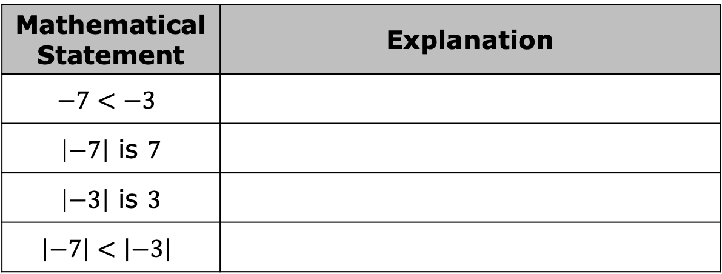
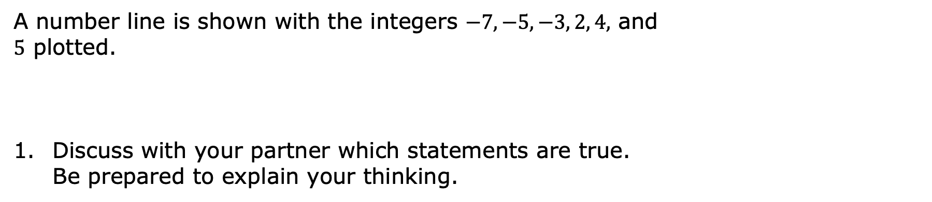
4.10.2 Guided Instruction: Comparing Absolute Values
A number line is shown with the integers $−7, −5, −3, 2, 4,$ and $5$ plotted.
Discuss with your partner which statements are true. Be prepared to explain your thinking.
Mathematical Statement | Explanation
$$−7<−3$$
$\left|−7\right|$ is $7$
$\left|−3\right|$ is $3$
$$\left|−7\right|<\left|−3\right|$$
volume 1, pg. 184

Slide 11
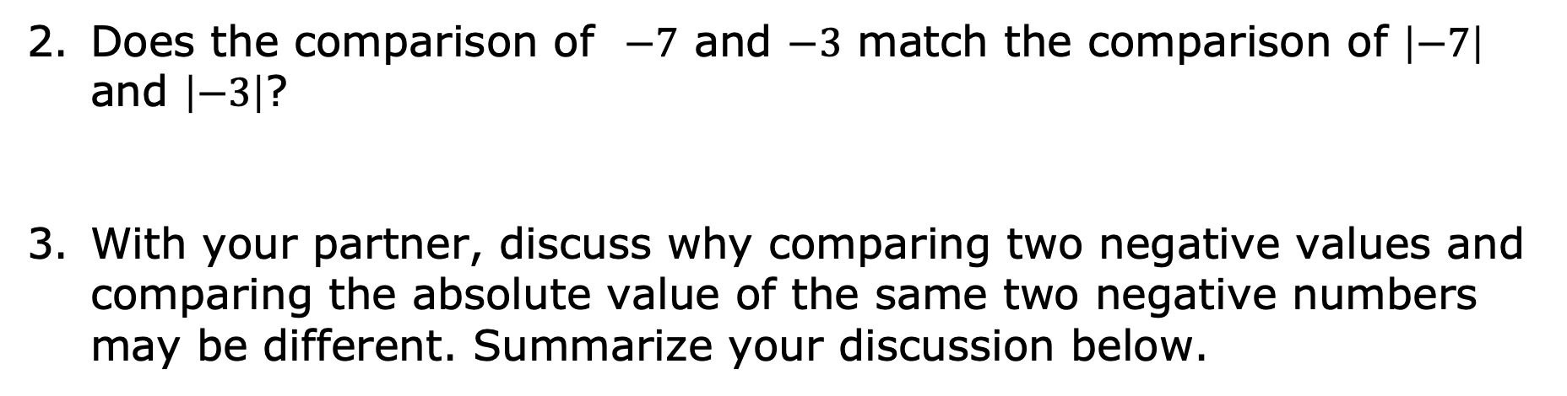
Does the comparison of $−7$ and $−3$ match the comparison of $\left|−7\right|$ and $\left|−3\right|$?
With your partner, discuss why comparing two negative values and comparing the absolute value of the same two negative numbers may be different. Summarize your discussion below.
volume 1, pg. 184

Slide 12
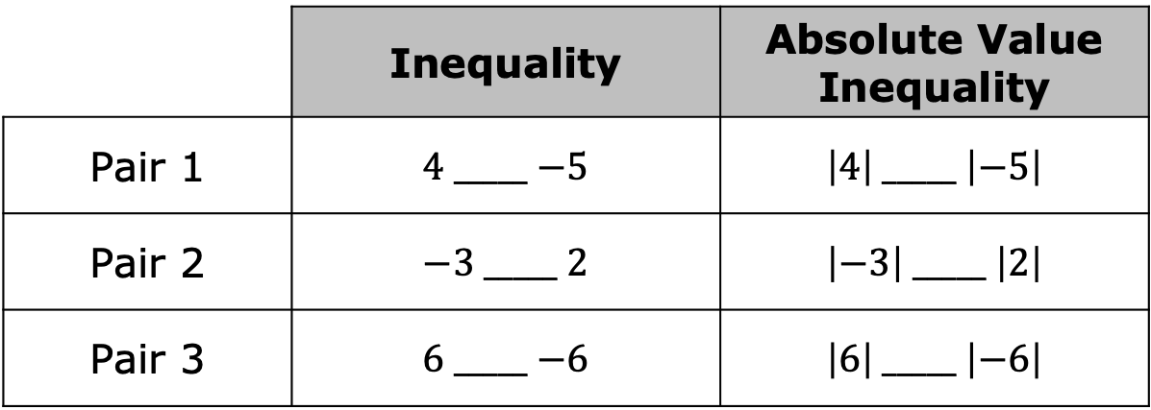

For each row, use the symbols $>, <$ , or $=$ to compare each pair of values.
What do you notice about the comparisons?
When comparing the absolute values of two numbers, numbers that are closer to zero will always have the __________ absolute value.
 | Inequality | Absolute Value Inequality
Pair 1 | $4$ _____ $−5$ | $\left|4\right|$ _____ $\left|−5\right|$
Pair 2 | $−3$ _____ $2$ | $\left|−3\right|$ _____ $\left|2\right|$
Pair 3 | $6$ _____ $−6$ | $\left|6\right|$ _____ $\left|−6\right|$
volume 1, pg. 185

Slide 13

Collaboration
volume 1, pg. 185

Slide 14

4.10.3 Collaboration: Inequality Mix and Match
Work with your partner to complete the table. Partner A will select two numbers and one comparison symbol. At least one of the numbers must be written as an absolute value. Partner B will then write the mathematical statement in words. The following phrases may be helpful: is equal to, the absolute value of, is greater than, is less than.
volume 1, pg. 185

Slide 15
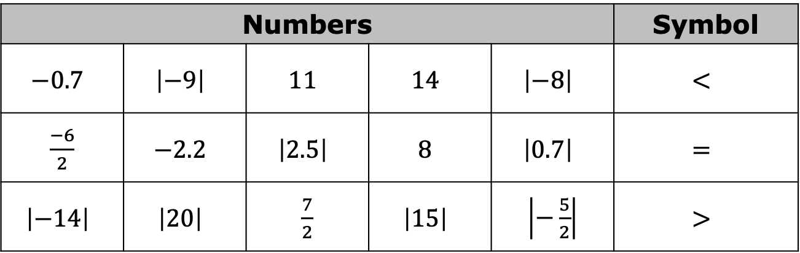
Switch roles until each partner has taken two turns. An example is shown in the first row.
Numbers |  |  |  |  | Symbol
$$−0.7$$ | $$\left|−9\right|$$ | $$11$$ | $$14$$ | $$\left|−8\right|$$ | $$<$$
$\frac{−6}{2}$ | $$−2.2$$ | $$\left|2.5\right|$$ | $$8$$ | $$\left|0.7\right|$$ | $$=$$
$$\left|−14\right|$$ | $$\left|20\right|$$ | $\frac{7}{2}$ | $$\left|15\right|$$ | $\left|−\frac{5}{2}\right|$ | $$>$$
volume 1, pg. 185

Slide 16
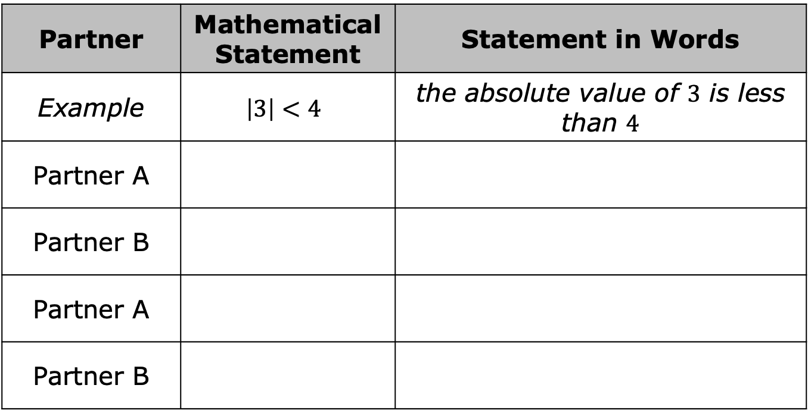
Partner | Mathematical Statement | Statement in Words
Example | $$\left|3\right|<4$$ | the absolute value of $3$ is less than $4$
Partner A
Partner B
Partner A
Partner B
volume 1, pg. 185

Slide 17
Guided Instruction
volume 1, pg. 186

Slide 18
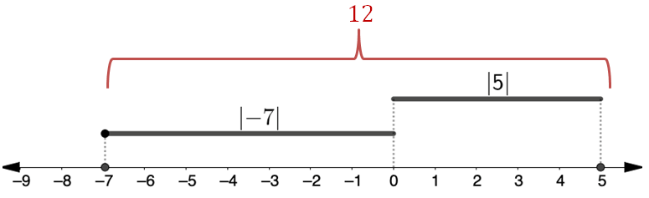
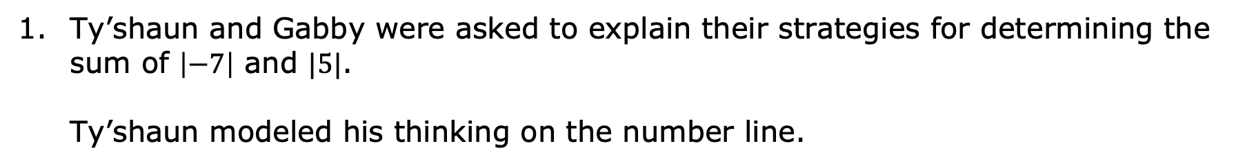
4.10.4 Guided Instruction: Operations Using Absolute Value
Ty’shaun and Gabby were asked to explain their strategies for determining the sum of $\left|−7\right|$ and $|5|$. Ty’shaun modeled his thinking on the number line.
volume 1, pg. 186

Slide 19
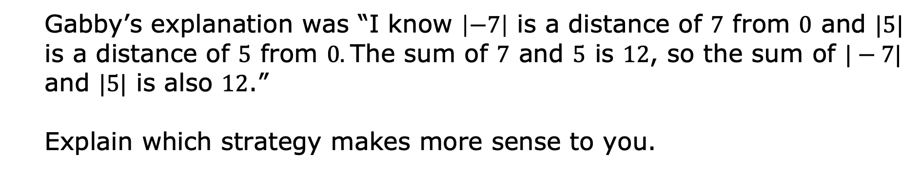
Gabby’s explanation was “I know $\left|−7\right|$ is a distance of $7$ from 0 and $|5|$ is a distance of $5$ from 0. The sum of $7$ and $5$ is $12$, so the sum of $|−7|$ and $|5|$ is also $12$.”
Explain which strategy makes more sense to you.
volume 1, pg. 186

Slide 20
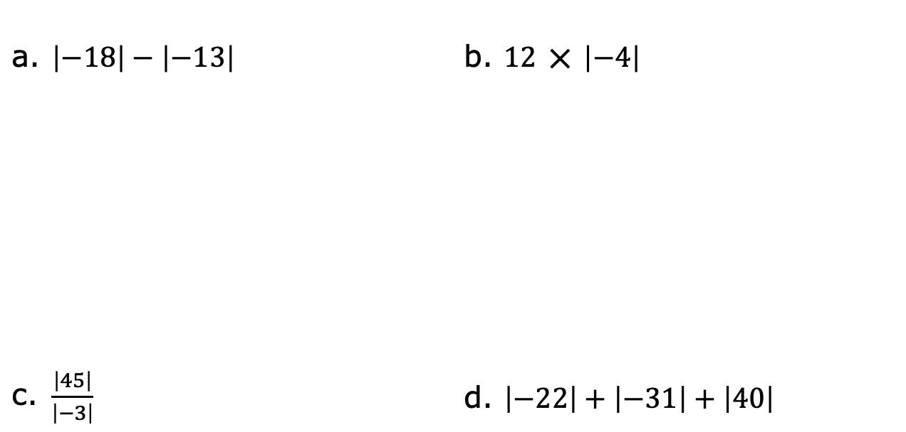
Find the value of each expression.
a. $\left|−18\right|−\left|−13\right|$ | b. $12 ⨉{ \left|−4\right|}$
c. $\frac{\left|45\right|}{\left|−3\right|}$ | d. $\left|−22\right|+\left|−31\right|+\left|40\right|$
volume 1, pg. 186

Slide 21

Your Turn
volume 1, pg. 187

Slide 22
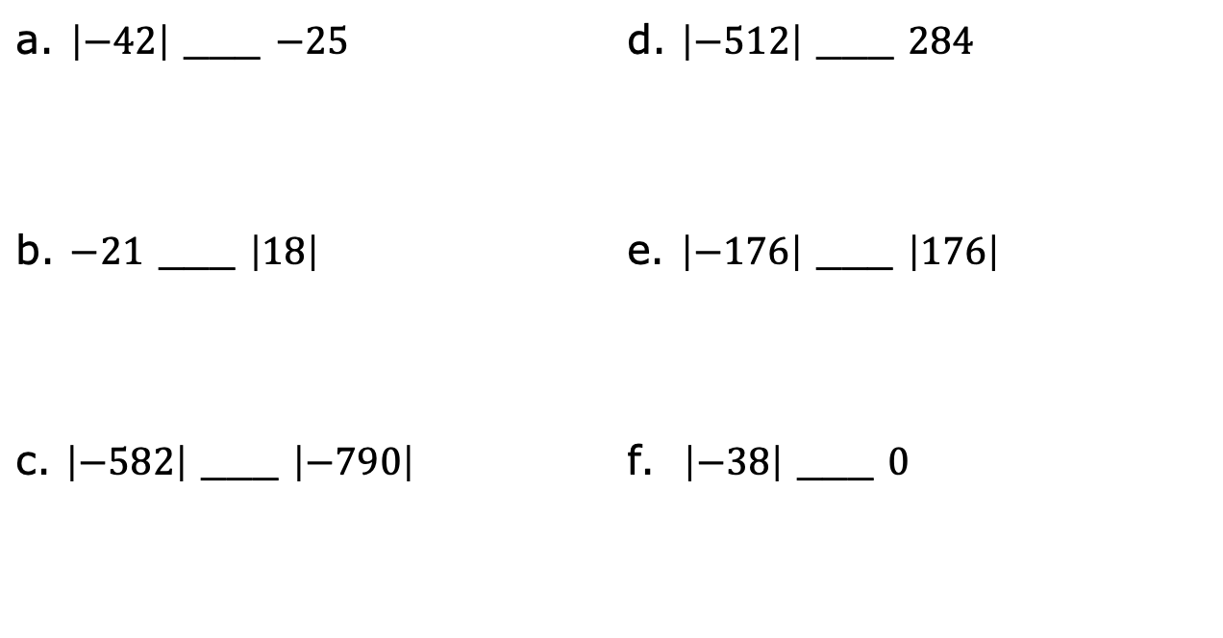

4.10.5 Your Turn!
Use the symbols $> , < ,$ or $=$ to compare each pair of values.
a. $\left|−42\right|$ ___ $−25$ | d. $\left|−512\right|$ ___ $284$
b. $−21$ ___ $\left|18\right|$ | e. $\left|−176\right|$ ___ $\left|176\right|$
c. $\left|−582\right|$ ___ $\left|−790\right|$ | f. $\left|−38\right|$ ___ $0$
volume 1, pg. 187

Slide 23

Find the value of each expression.
a. $\left|−58\right|+12=$ _____
b. $\left|−13\right|×5=$ _____
c. $\frac{\left|−36\right|}{\left|9\right|}=$ _____
volume 1, pg. 187

Slide 24

Wrap-Up
volume 1, pg. 187

Slide 25
4.10.6 Wrap-Up: Reflection
Place an X on the line to indicate your understanding of each of today’s learning targets. Then provide a brief explanation or evidence to support your self-assessment.
I can compare the absolute value of two numbers.
I can perform operations that involve the absolute value of two numbers.
I need help. I can’t get started. | I’m getting there. | I understand and have evidence.
I need help. I can’t get started. | I’m getting there. | I understand and have evidence.
volume 1, pg. 187

